Slide 1
HTML – Continued..
Instructor: Manu Peethambar
E-mail: cm13055@umbc.edu
Telegram handle: @manupeethambar888
Slides: https://github.com/manupeethambar888/webdev

Slide 2

HTML Iframes
An iframe is used to display a web page within a web page.
An HTML iframe is defined with the <iframe> tag:
Iframe - Target for a Link
The target attribute of the link must refer to the name attribute of the iframe:
Practice: https://www.w3schools.com/html/html_iframe.asp

Slide 3
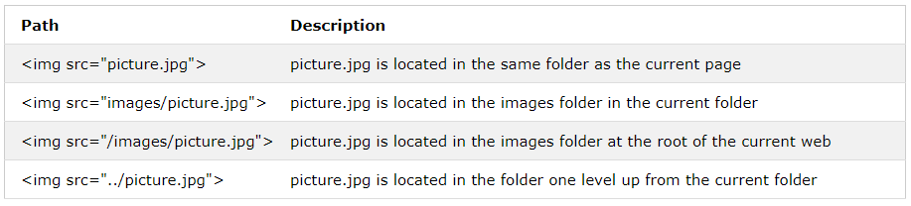
HTML File Paths
A file path describes the location of a file in a web site's folder structure.
File paths are used when linking to external files like:
Web pages
Images
Style sheets
JavaScripts

Slide 4
HTML File Paths
Absolute File Paths
An absolute file path is the full URL to an internet file:
Relative File Paths
A relative file path points to a file relative to the current page.
In this example, the file path points to a file in the images folder located at the root of the current web:

Slide 5
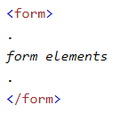
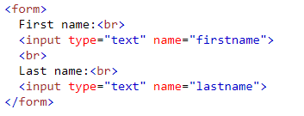
HTML Forms
The HTML <form> element defines a form that is used to collect user input:
An HTML form contains form elements.
Form elements are different types of input elements, like text fields, checkboxes, radio buttons, submit buttons, and more.

Slide 6
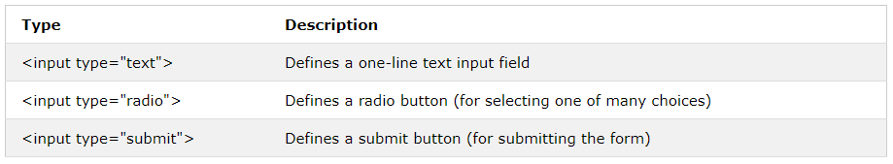
HTML Form Elements
The <input> Element
The <input> element is the most important form element.
The <input> element can be displayed in several ways, depending on the type attribute.

Slide 7
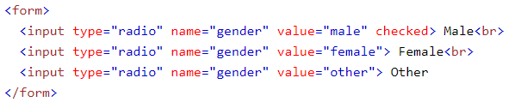

HTML Form Elements
Radio Button Input
<input type="radio"> defines a radio button.
Radio buttons let a user select ONE of a limited number of choices:

Slide 8
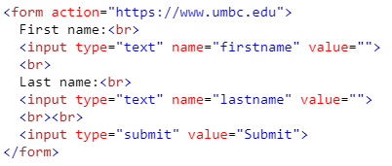
HTML Form Elements
The Submit Button
<input type="submit"> defines a button for submitting the form data to a form-handler.
The form-handler is typically a server page with a script for processing input data.
The form-handler is specified in the form's action attribute:

Slide 9
HTML Form Elements
The Target Attribute
The target attribute specifies if the submitted result will open in a new browser tab, a frame, or in the current window.
The default value is "_self" which means the form will be submitted in the current window.
To make the form result open in a new browser tab, use the value "_blank":

Slide 10
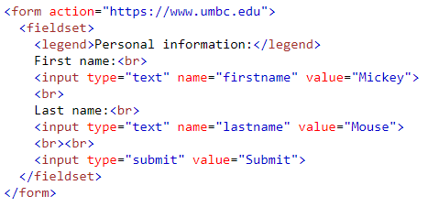
HTML Form Elements
Grouping Form Data with <fieldset>
The <fieldset> element is used to group related data in a form.
The <legend> element defines a caption for the <fieldset> element.

Slide 11
Assignment 6 due – 7/3/2018
Create a sample html file:
Make a HTML form containing a label named “Name” an <input> element for Name type=“text“.
Add 2 radio buttons to the form. One for "male", and one for "female", both with name="gender“.
Add action attribute to open www.google.com in a new tab/window on click of submit button.
Put this in a <fieldset> with a caption “Personal Information”.
Save this as “assignment6.html” and in your repository in Homework folder in “Assignments_yourname”.
Commit and push the changes to the repository.

